Slide 1

A Project on
SELF-SUPERVISED CONTRASTIVE LEARNING FOR DOPPLER
REGIME CLASSIFICATION IN OTFS SYSTEMS
Submitted in partial fulfillment of the requirements for the course
MACHINE LEARNING
25SC2107E
in
A.Y.: 2026-27
by
Name : LOKESH VOBILISHETTY
Name : KNSV MADHUSUDHAN
Name : VARANASI SREEKAR
roll no: 2520040040
roll no: 2520040089
roll no: 2520040019
Under the Esteemed guidance of
Mr. N Lava Prasad
Assistant Professor,
Department of ECE

Slide 2
PROJECT OVERVIEW
What This Project Does
The project builds a machine-learning system that looks at a wireless channel represented in the OTFS delay-Doppler domain and automatically recognises how much Doppler effect (caused by motion) is present — Low, Medium, or High — without needing a large hand-labelled dataset to train on.
INPUT
PROCESSING
OUTPUT
A delay-Doppler representation of a wireless channel, captured or simulated under some mobility condition.
A self-supervised contrastive encoder learns useful patterns from unlabelled channel data, then a lightweight classifier is fine-tuned on a small labelled set.
A predicted Doppler regime — Low, Medium, or High — that tells the receiver how to adapt its processing.
In short: the model reads a channel snapshot and tells the system how “fast-moving” that channel environment is — a key piece of information for keeping a wireless link reliable.
Self-Supervised Contrastive Learning for Doppler-Regime Classification in OTFS Systems — Review II
2

Slide 3
PROBLEM STATEMENT
Why This Is Difficult to Solve
High-mobility scenarios cause wireless channels to change continuously, introducing Doppler shifts that degrade communication performance. OTFS represents the channel in the delay-Doppler domain, but a receiver must still know the prevailing Doppler regime to process the signal correctly.
Doppler regimes to be classified
Regime | Characteristic
Low Doppler | Minimal frequency shift; low mobility
Medium Doppler | Moderate shift from mid-range mobility
High Doppler | Large, fast-varying shift from high mobility
Channel conditions vary rapidly and unpredictably with user mobility.
Low, Medium, and High Doppler behaviour are hard to separate reliably.
Large, accurately labelled channel datasets are costly and slow to collect.
Conventional supervised models do not scale without abundant labelled data.
Self-Supervised Contrastive Learning for Doppler-Regime Classification in OTFS Systems — Review II
3

Slide 4
USER BENEFIT
How This Helps the User
Knowing the Doppler regime lets a receiver adapt automatically, instead of using a one-size-fits-all configuration. That translates into a noticeably better experience for anyone relying on the connection.
Fewer Dropped Connections
Better Speed When It Matters
The receiver adjusts its processing as conditions change, so calls, video, and data links stay stable during fast movement.
Accurate regime detection avoids unnecessarily conservative settings, keeping throughput higher in easy (Low Doppler) conditions.
Lower Cost to Deploy
Future-Ready for 5G/6G
Because the model needs only a small labelled dataset, operators can roll it out without expensive large-scale data collection.
Supports emerging high-mobility use cases — connected vehicles, drones, trains, satellites — where reliability is safety-critical.
Self-Supervised Contrastive Learning for Doppler-Regime Classification in OTFS Systems — Review II
4

Slide 5
PROPOSED METHODOLOGY
A Self-Supervised, Contrastive Approach
Rather than relying on large labelled datasets, the model learns channel representations directly from unlabelled delay-Doppler data by contrasting augmented views of the same channel against those of different channels.
Contrastive Learning
Self-Supervision
Representations of the same Doppler regime are pulled together; different regimes are pushed apart in embedding space.
No manual labels are needed for pretraining; the model learns from the structure of the data itself.
Two-Stage Design
Label Efficiency
Unsupervised representation learning is followed by lightweight supervised fine-tuning.
Only a small labelled subset is required to fine-tune the final classifier.
Self-Supervised Contrastive Learning for Doppler-Regime Classification in OTFS Systems — Review II
5

Slide 6
DATASET
Dataset Description
A synthetic delay-Doppler feature dataset was generated to reflect realistic channel behaviour across the three Doppler regimes, for self-supervised pretraining and supervised fine-tuning / evaluation.
Property | Detail
Source | Synthetically generated to model OTFS delay-Doppler channel behaviour
Total samples | 180 samples — 60 per Doppler class (balanced)
Classes | Low Doppler, Medium Doppler, High Doppler
Features | Doppler shift (Hz), delay spread (µs), no. of multipath components, SNR (dB), coherence time (ms), peak power (dB)
Missing values | None — dataset is complete
Usage split | Unlabelled pretraining set + small labelled fine-tuning / test set
Sample records
ID | Class | Doppler (Hz)
S0001 | Low | 125.4
S0075 | Medium | 598.1
S0162 | High | 1942.6
Self-Supervised Contrastive Learning for Doppler-Regime Classification in OTFS Systems — Review II
6

Slide 7
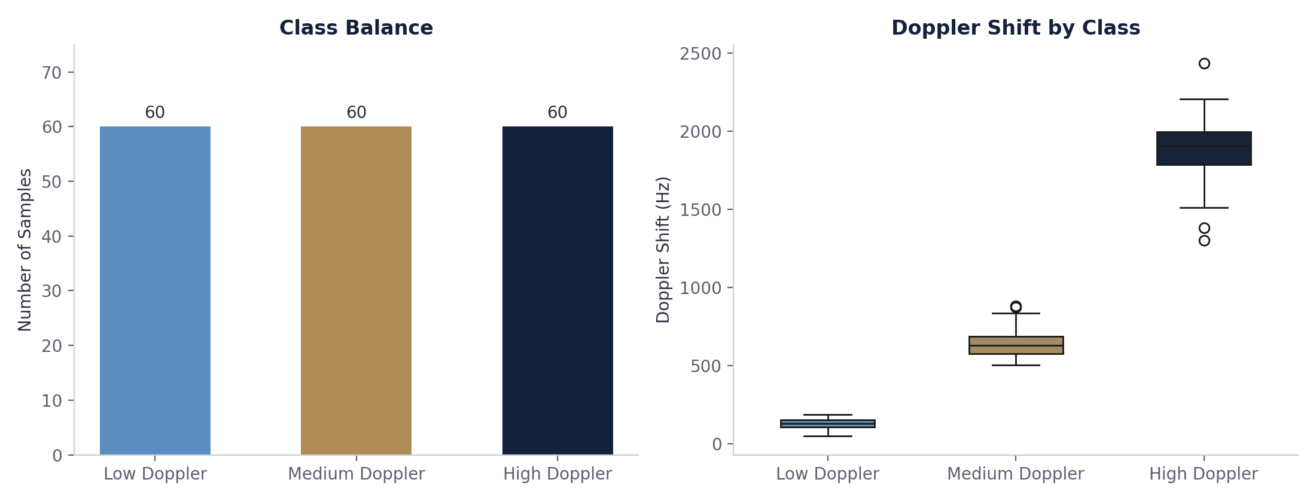
EXPLORATORY DATA ANALYSIS
Class Balance and Doppler Shift Separation
The dataset is perfectly balanced (60 samples per class). Doppler shift values separate cleanly across the three regimes, confirming the feature is highly discriminative for this task.
Self-Supervised Contrastive Learning for Doppler-Regime Classification in OTFS Systems — Review II
7

Slide 8
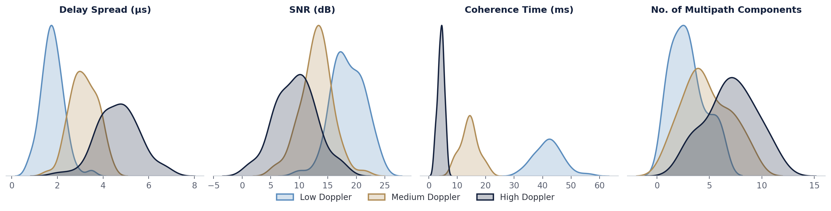
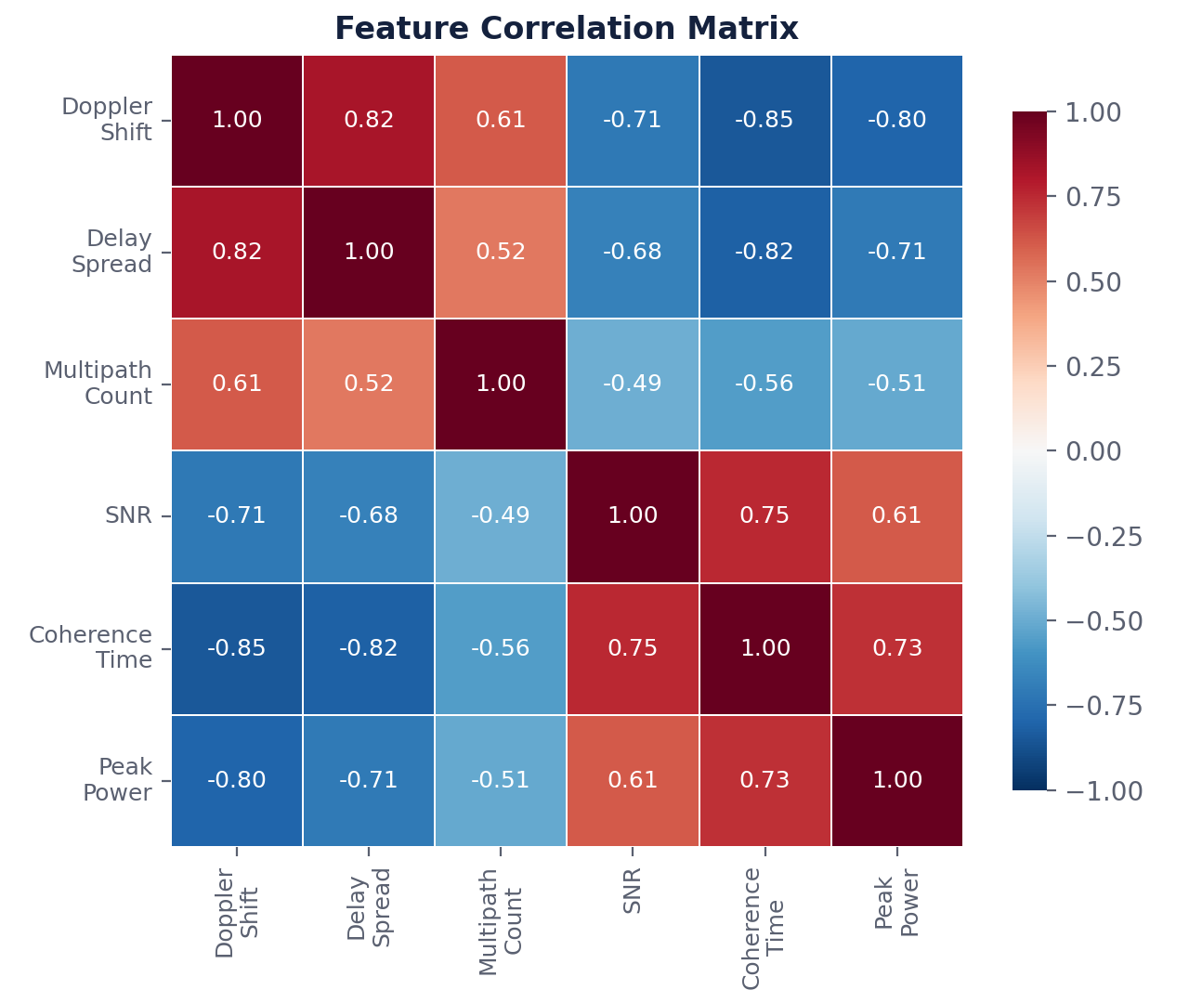
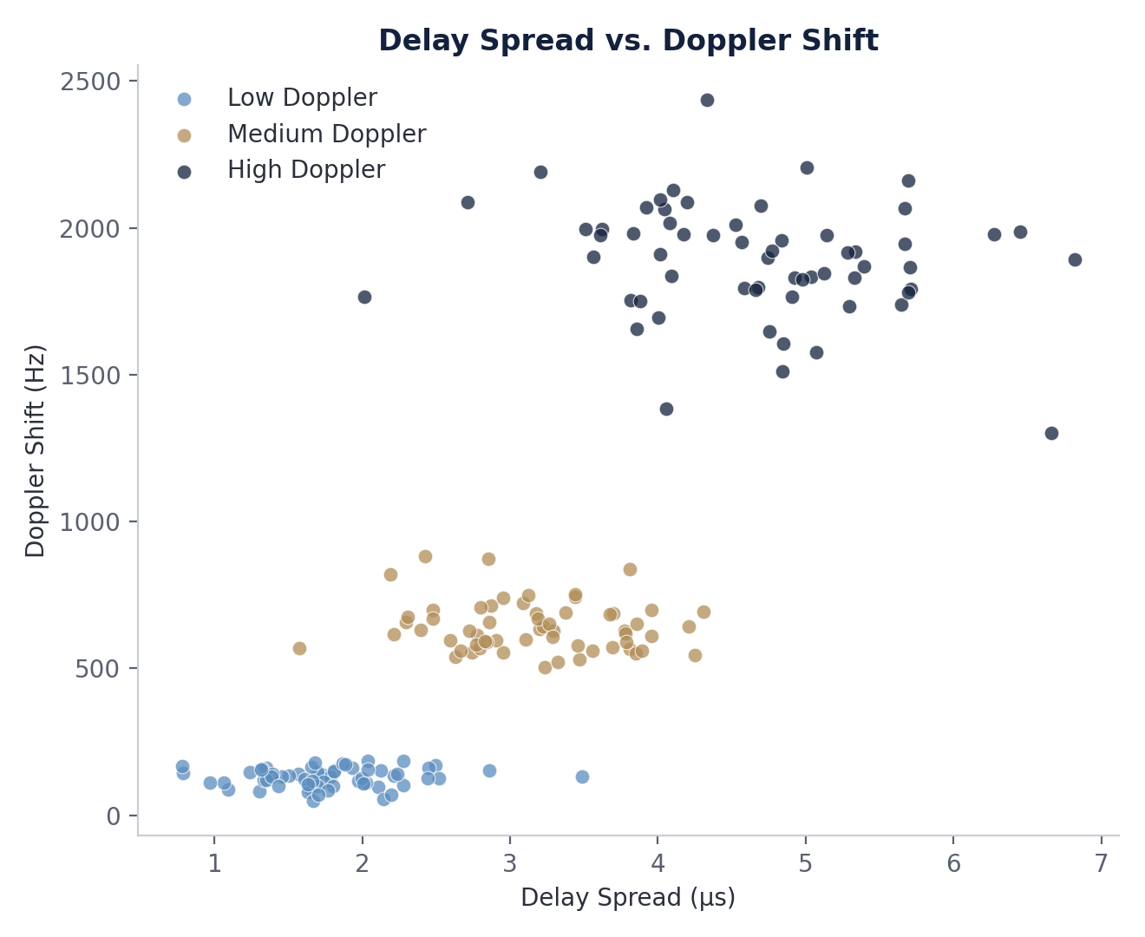
EXPLORATORY DATA ANALYSIS
Feature Distributions and Correlation
Per-class feature distributions
Correlation matrix
Delay spread vs. Doppler shift
Self-Supervised Contrastive Learning for Doppler-Regime Classification in OTFS Systems — Review II
8

Slide 9
IMPLEMENTATION
Project Workflow
STEP 1
STEP 2
STEP 3
Simulate OTFS channels under varying mobility speeds
Transform channel data into the delay-Doppler representation
Generate contrastive augmentation pairs
STEP 4
STEP 5
STEP 6
Self-supervised pretraining of the encoder
Fine-tune the CNN classifier on limited labels
Evaluate and interpret Doppler-regime predictions
Tools: Python (PyTorch) for model development; MATLAB for OTFS channel and mobility simulation.
Self-Supervised Contrastive Learning for Doppler-Regime Classification in OTFS Systems — Review II
9

Slide 10
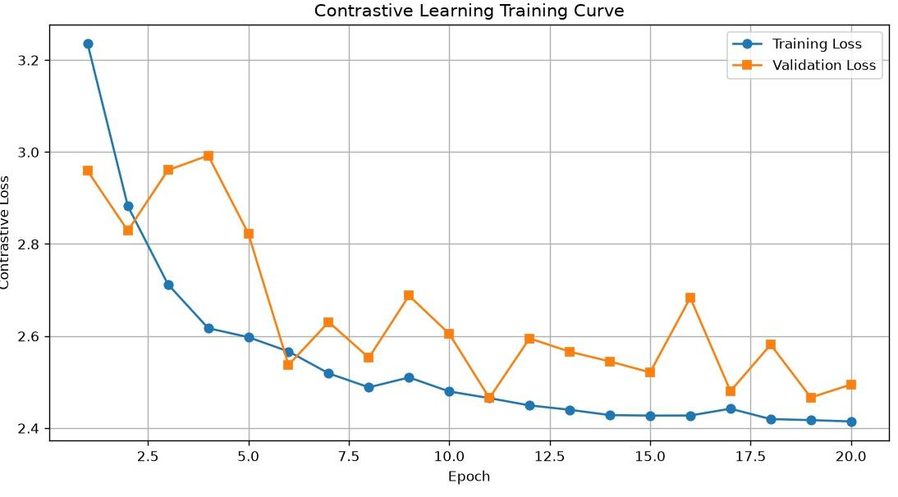
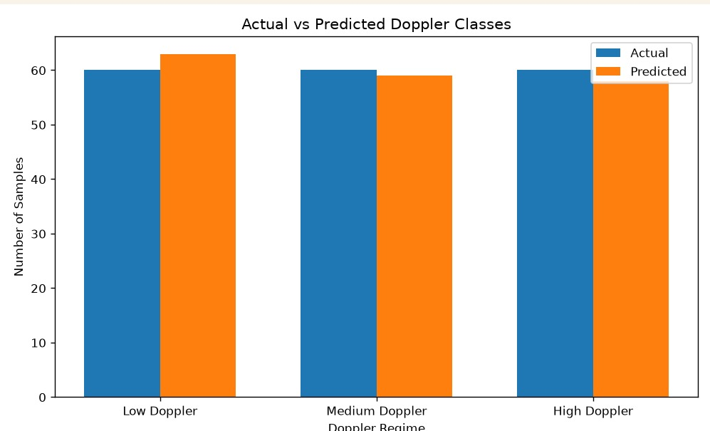
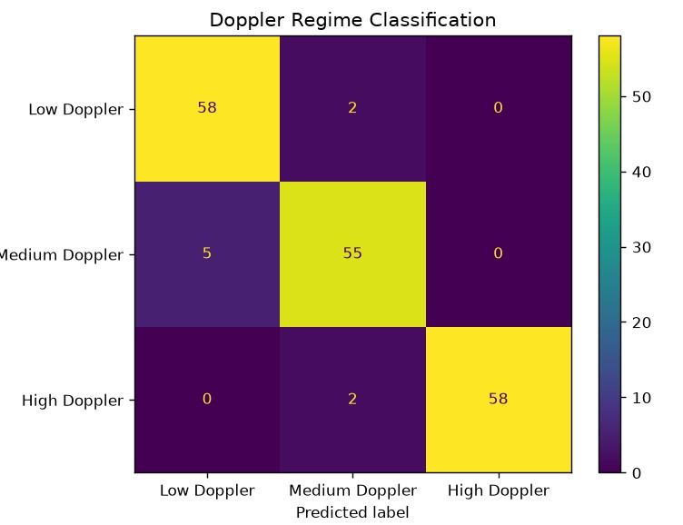
RESULTS
Experimental Results
Contrastive learning training curve
Actual vs. predicted samples
Confusion matrix
95.0% Overall Accuracy (171/180)
96.7% Low Doppler Accuracy
91.7% Medium Doppler Accuracy
96.7% High Doppler Accuracy
Self-Supervised Contrastive Learning for Doppler-Regime Classification in OTFS Systems — Review II
10

Slide 11
REMAINING WORK
Roadmap to Project Completion
No. | Task | Description
1 | Expand dataset diversity | Extend simulation to additional SNR levels and mobility profiles for broader generalisation.
2 | Benchmark against baseline | Compare with a fully-supervised CNN to quantify label-efficiency gains.
3 | Robustness testing | Stress-test the classifier across the full simulated SNR range.
4 | Final evaluation and report | Consolidate results, analyse robustness, and prepare final documentation.
Self-Supervised Contrastive Learning for Doppler-Regime Classification in OTFS Systems — Review II
11

Slide 12
CONCLUSION
A data-efficient path to reliable
high-mobility wireless communication
Removes dependency on large labelled Doppler-regime datasets.
Achieves 95.0% accuracy on a balanced, held-out evaluation set.
Directly benefits users through more stable, efficient high-mobility connections.
Next steps: broaden the dataset, benchmark, and finalise the report.
Thank you

